Slide 1
Code4Good Team ???
First Meeting

Slide 2
Introductions
https://github.com/spaceraccoon
Class of 2018, History and Computer Science
Government Technology
Current Projects:
AI startups
Consumer tech startup
Code4Good
Current Jobs:
Lead developer, Project Anqa (Iron Mountain/ICOMOS/DH@Yale)
Web developer, Yale College Web Operations

Slide 3
The Web Developer Stack
Deploy
Web Frameworks
Language

Slide 4
Environment Set-Up
Git – Version Control
Node – Javascript Runtime
Yarn – Package Management
Python – Programming language
Atom – Text Editor

Slide 5
Environment Set-Up
MacOS: http://www.stuartellis.name/articles/mac-setup/
Setting Up for Development
Getting Xcode
Setting Up Homebrew
Installing the Git Version Control System
Choosing a Text Editor
Setting Up Environments
nvm and Yarn for Node.js Development
pyenv for Python Development
Windows:
https://github.com/felixrieseberg/windows-development-environment/blob/master/README.md
Git
Atom
No Visual Studio
Python

Slide 6
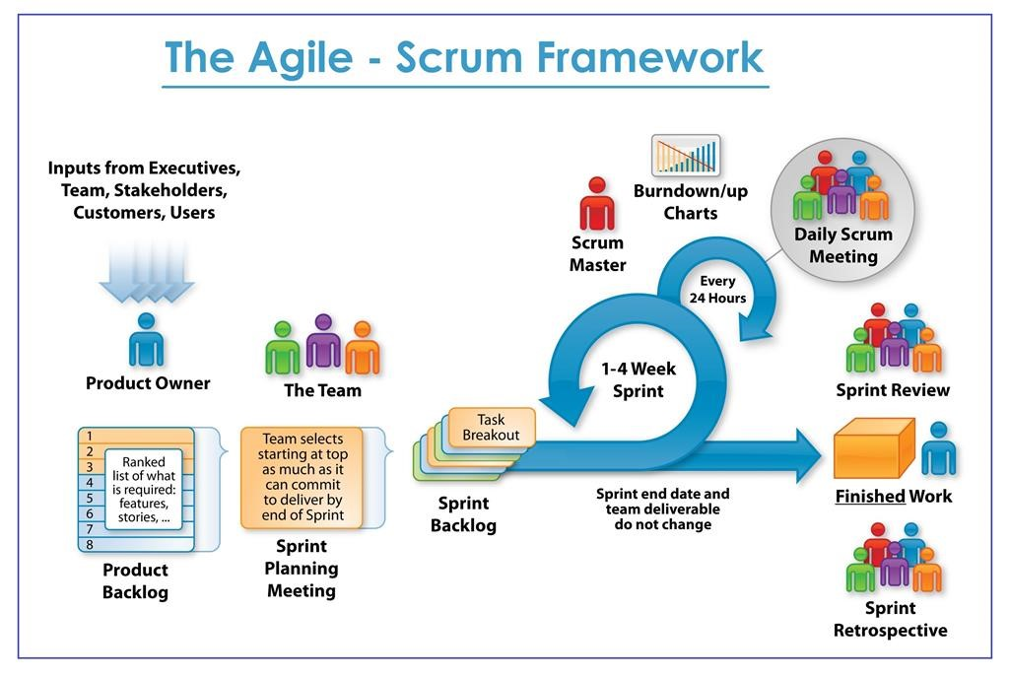
Agile-Scrum Framework

Slide 7
Our Timeline
Starter Project
Crash Course
MakeHaven Project

Slide 8
First Task: Git
https://www.atlassian.com/git/tutorials/setting-up-a-repository

